Slide 1


DevOps Docker

Slide 2




Prerequisite
Use Workshop-VM / Workshop-Computer follow the instructions of the Boarding Pass
Visual Studio Code
https://code.visualstudio.com
Git
https://git-scm.com
Competence Team DevTech
Microsoft AL

Slide 3
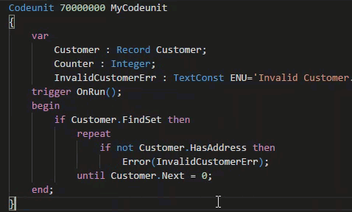
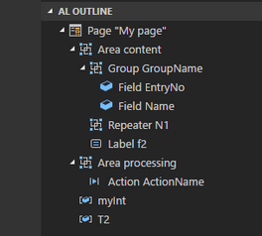
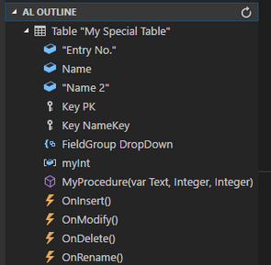
VS Code Useful Extensions
AL Formatter
Indentation
Keyword case style
Sort variable definitions
Readability Guidelines - Spacing and newlines (experimental)
AL Code Outline
Outlining – AL Object Structure
“Create List Page” from Table
“Create Card Page” from Table
al-util
“Rename & Move” Objects
Templates e.g. “Readme.md”

Slide 4


1
Docker, NAV on Docker, Docker Commands
2
Hand On
AGENDA
3
NAV Container Helper (Powershell)
4
Hands On
5
Q & A

Slide 5

Infrastructure
Docker
5

Slide 6

Infrastructure | Docker www.docker.com Overview
Isolate application's view of the operating environment
Easy & Simple Application Deployment
Requirements
Windows 10 / Windows Server 2016
Recommended 16GB Ram & 40 GB HDD on C:
Hyper-V enabled
Install Docker for Windows
After Docker Installation
Switch Container Mode to “Windows” (Docker @ Taskbar Icon → [Right Click] Menu → Switch to Windows Container Mode) this may require a restart
Documentation
Source: https://de.wikipedia.org/wiki/Datei:Docker_(container_engine)_logo.png

Slide 7
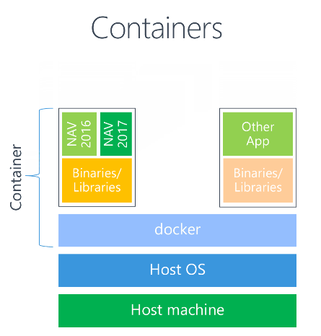
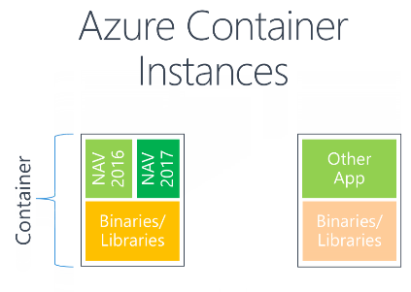
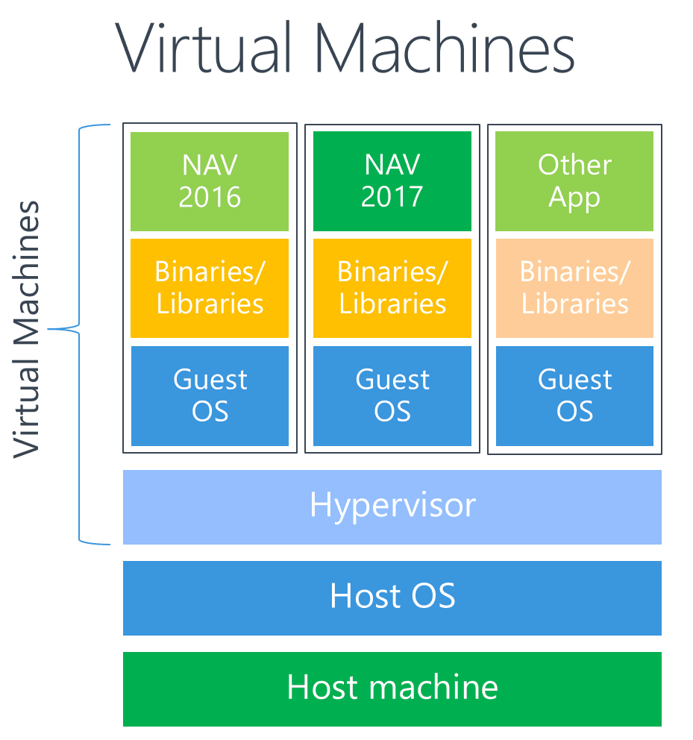
Infrastructure | Docker NAV in Containers
Source: https://blogs.msdn.microsoft.com/freddyk/2017/10/31/what-is-docker-what-are-containers/

Slide 8
Infrastructure | Docker NAV Containers
Pull (Download the Image) Repository\<Image-Name>[:<Tag>]
NAV Container
Windows Server Nano
SQL Server Express CORNUS DB
Web-Server
Navision in the right version: NST, WebClient, RTC, C/Side (FinSQL.exe)
Folders
Volume Mapping
Local Machine
Container
-v “<OutSide>:<InSide>”
D:\Temp\ContainerXYZ\my
C:\Run\My
D:\Temp\ContainerXYZ\myAddins
C:\Run\AddIns

Slide 9
Docker Common Commands Cheat-Sheet
List all containers
$ docker ps -a
List all images
$ docker images -a
Fetch the logs of a container
$ git logs <container ID or Name>
Kill a container
$ docker kill <container ID or Name>
Remove a containers
$ docker rm <container ID or Name>
Remove a container image
$ docker rmi <image ID>
Pull a container from registry
$ docker pull <registry>/<image>[:<tag>]

Slide 10

Hands On

Slide 11
Docker Hands On
Prerequisites
Connect to your Workshop VM → use Instructions on your Workshop Boarding Pass
Hand On - Tasks
Learn how to interact with docker
Pull some containers
Get some information from the container

Slide 12
Docker Hands On
Open your PowerShell (Admin Mode)
Which docker images are present at the machine?
Which Container are running?
Query the Log-Information of a running container!
Pull / Update an image
Docker Registry: microsoft
Docker Image: dynamics-nav
Docker Tag: 2018-cu5-de
$ docker ps -a
$ docker images -a
$ git logs <container ID or Name>
$ docker pull <registry>/<image>[:<tag>]

Slide 13

Infrastructure
NAV-Container-Helper
13

Slide 14
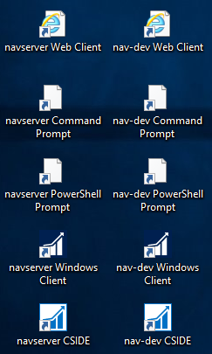
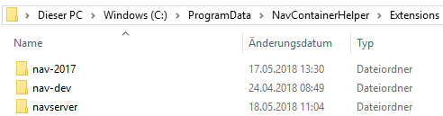
NAV Container Helper Introduction
Freddy DK Microsoft
Install on Windows: https://blogs.msdn.microsoft.com/freddyk/2018/03/20/navcontainerhelper-1/
Setup CSIDE development environment with source code management https://blogs.msdn.microsoft.com/freddyk/2018/03/22/navcontainerhelper-setup-cside-development-environment-with-source-code-management/
GitHub https://github.com/Microsoft/navcontainerhelper
Windows 10 or 2016 Server & Docker required
Installation PowerShell
Local Container Path
$ install-module navcontainerhelper -force
$ C:\ProgramData\NavContainerHelper\Extensions\

Slide 15
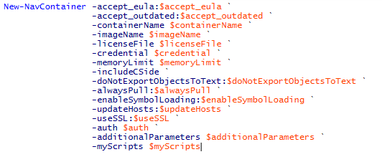
NAV Container Helper Introduction
Pull & Setup Containers for NAV
The Right NAV-Image
Import license file
Mount Volumes (PS-Scripts, Add-ins, DB-Backup Dir)
Authentication
Symbols Loading
Import/Export Objects, Database, Apps (PowerShell)

Slide 16
NAV Container Helper Common Commands Cheat-Sheet
List common Commands
$ Write-NavContainerHelperWelcomeText
Create new C/SIDE development container
$ New-CSideDevContainer -accept_eula -containerName <name> -imageName "Microsoft/dynamics-nav:2018-cu4-de“ …
Create new Nav container
$ New-NavContainer -accept_eula -containerName <name> -imageName "Microsoft/dynamics-nav:2018-cu4-de“ …
$
$
$
$

Slide 17
Hands On

Slide 18
Docker NAV Container Helper
Material
Project Skeleton „04-DevOps-Docker\Starter\COSMO-CONSULT-1\”
Prerequisites
Connect to your Workshop VM → use Instructions on your Workshop Boarding Pass
Hand On - Tasks
Learn how to setup a development environment
Create and access a dev container with C/Side, RTC & WebClient short cuts
Develop against to the Container

Slide 19
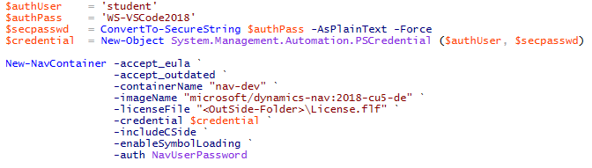
Docker NAV Container Helper
Open your PowerShell ISE (Admin Mode)
Create a new Container with NavContainerHelper
Docker Registry: microsoft
Docker Image: dynamics-nav
Docker Tag: 2018-cu5-de
Container Name: nav-dev
Run the Script
$ docker pull <registry>/<image>[:<tag>]

Slide 20
Docker NAV Container Helper
Open your Project „…\Starter\COSMO-CONSULT-1\” in VS Code
Fix the „lauch.json“
Deploy and run the solution
TBD ☺

Slide 21

Q & A
Competence Team DevTech
Channel Microsoft AL

